Slide 1


Preventing Network Attacks: An Integrated Approach using Support Vector Machine (SVM) and Software Defined Networking (SDN)
Department of Information Technology
V R Siddhartha Engineering College
Network Security, Cyber Security
and Information Security
B.Tech in Information Technology
Mini Project Review Presentation
Presented by
Mr. Dinakar Laxmi Viswanath (208W1A1201)
Mr. Sotsava Skandhaa (208W1A1202)
Under the guidance of
S. Kranthi , Assistant professor

Slide 2
AGENDA
Introduction
Problem Definition
Objectives and Outcomes
State-of-the-Art
Dataset Description
Architecture diagram
Algorithms
Implementation Steps
Result Analysis
Conclusion
References

Slide 3
INTRODUCTION
The field of network security is a critical aspect of modern computing systems, with software-defined networking (SDN) offering new opportunities for effective security. The objective of this project is to explore the potential of deep learning algorithms for intrusion detection in SDN environments. The project involves selecting a DDOS attack network security dataset from Kaggle and using deep learning techniques to train a model that can detect and classify different types of attacks. The trained model will be integrated with a software-defined network (SDN) environment, which will use controllers to block the detected attack. This project aims to demonstrate the feasibility and effectiveness of deep learning for intrusion detection in SDN and contribute to the advancement of network security research.

Slide 4
PROBLEM DEFINITION
The increasing number of cyber-attacks on networks has become a major concern for organizations and individuals. Traditional security solutions, such as firewalls and intrusion detection systems, are becoming less effective in defending against these attacks. This project aims to address this problem by using a deep learning model-based solution for detecting and preventing DDOS network attacks in a software-defined networking (SDN) environment. The solution uses a trained linear Support Vector Machine (SVM) algorithm model to control the behavior of one or more SDN controllers to prevent attacks.

Slide 5
OBJECTIVES
To develop an efficient machine learning model that can classify the given network traffic dataset to various attacks with maximum accuracy.
Using SDN controllers to stop traffic from a host based on its Mac address.

Slide 6
OUTCOMES
A working machine learning-based solution for network security that can detect and prevent network attacks in a software-defined networking environment.
Improved understanding of the integration of deep learning models into a software-defined networking environment.

Slide 7
STATE-OF-THE-ART
Title of the Project | Authors | Methodology | Source | Summary
A Flow-Based Anomaly Detection Approach With Feature Selection Method Against DDoS Attacks in SDNs | Mahmoud Said El Sayed Nhien-An Le-Khac , Marianne A. Azer and Anca D. Jurcut (2020) | LSTM-Autoencoder | IEEE TRANSACTIONS ON COGNITIVE COMMUNICATIONS AND NETWORKING | Our approach provides a high detection rate and presents a more efficient better time to build the model. We further tested the trained model on the performance of the SDN controller to evaluate how the used dataset can impact on the performance of the SDN controller. The results showed that the proposed approach does not deteriorate the network performance
Deep Neural Networks for Intrusion Detection in Software-Defined Networking | Wang et al. (2019) | Random Forests | IEEE (Institute of Electrical and Electronics Engineers) | The authors evaluate the performance of their proposed solution using both simulated and real-world network security datasets and show that deep neural networks can significantly improve the accuracy of intrusion detection in SDN environments.

Slide 8
Title of the Project | Authors | Methodology | Source | Summary
End-to-end intrusion detection in software-defined networks using deep reinforcement learning | Qin et al. (2019) | A K-mean clustering and random forest based multilevel model . | IEEE (Transactions on Network and Service Management) | The proposed solution can effectively detect various types of network attacks in real-time and provide a flexible and scalable solution for SDN security.
Anomaly-based Intrusion Detection in Software-Defined Networks: A Deep Learning Approach | Zhang et al. (2019) | Naïve Bayes classifier | IEEE Access | The proposed method uses an autoencoder to learn the normal behavior of the network and identify anomalies, which are then classified as either benign or malicious using a deep neural network.
Distributed abnormal behavior detection approach | Naila Marir HuiqiaWaGuangsheBingyang | DBN and SVM | IEEE, 2018 | DBN is used to extract SVM ensemble characteristics and to anticipate the voting process.

Slide 9
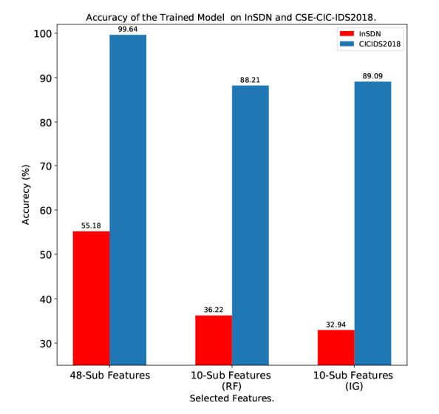
REVIEW PAPER : Mahmoud Said El Sayed Nhien-An Le-Khac , Marianne A. Azer and Anca D. Jurcut. "A Flow-Based Anomaly Detection Approach With Feature Selection Method Against DDoS Attacks in SDNs." In 2022 IEEE TRANSACTIONS ON COGNITIVE COMMUNICATIONS AND NETWORKING.
SUMMARY :

Slide 10
REVIEW PAPER : Mahmoud Said El Sayed Nhien-An Le-Khac , Marianne A. Azer and Anca D. Jurcut. "A Flow-Based Anomaly Detection Approach With Feature Selection Method Against DDoS Attacks in SDNs." In 2022 IEEE TRANSACTIONS ON COGNITIVE COMMUNICATIONS AND NETWORKING.
SUMMARY :
The aim of this work is to reduce the redundant or irrelevant features without any significant impact on the classification accuracy. We have selected 10 features out of available 48 features using two common feature selection methods IG and RF. The approach provides a high detection rate and presents a more efficient better time to build the model. We further tested the trained model on the performance of the SDN controller to evaluate how the used dataset can impact on the performance of the SDN controller. The results showed that the proposed approach does not deteriorate the network performance.

Slide 11
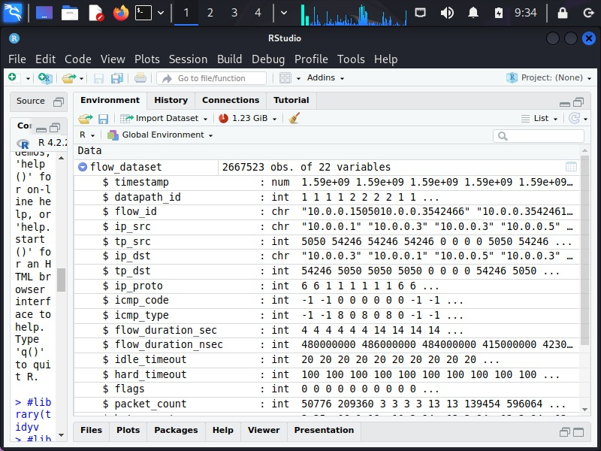
DATASET DESCRIPTION
We have a huge amount of data entries (2667523 Observations)
This is a snapshot of the sample data with column names.

Slide 12
REQUIREMENTS
User Interface:
This system's user interface is the Linux os, which is a user-friendly interface.
Hardware Interfaces:
Oracle Virtual Machine, Kali Linux, and Kaggle
Software Interfaces:
Required modules (tidyverse, e1071, caret, graphics, ggplot2, class, KNN, SVM)
Hardware Requirements:
Processor – Pentium-IV
RAM – 4GB (Minimum)
HDD/SSD – 256GB (Minimum)

Slide 13
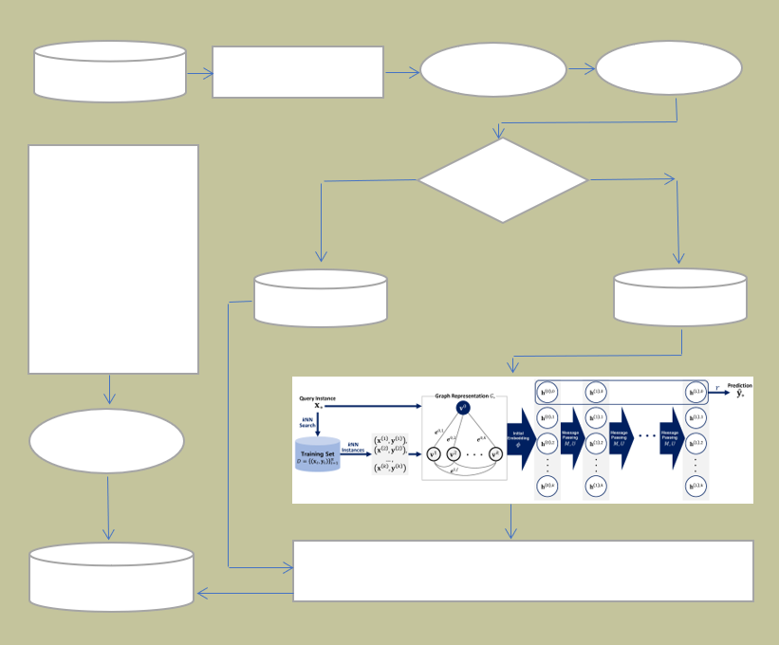

Architecture Diagram
PREPROCESSING THE DATA
LABEL ENCODER
Visualize the data
DATASET
BUILDING A NETWORK IN SDN ENVIRONMENT USING MININET CONSISTING OF 4 SERVERS, 6 SWITCHES AND 8 HOSTS WITH VPN.
Splitting of Data
TEST DATA
TRAIN DATA
ATTACK GENERATION AND GET THE CSV FILE
Use model to detect the attack and control it
VALIDATE THE MODEL USING TEST DATA AND CALCULATE THE PERFORMANCE METRIC ACCURACY

Slide 14
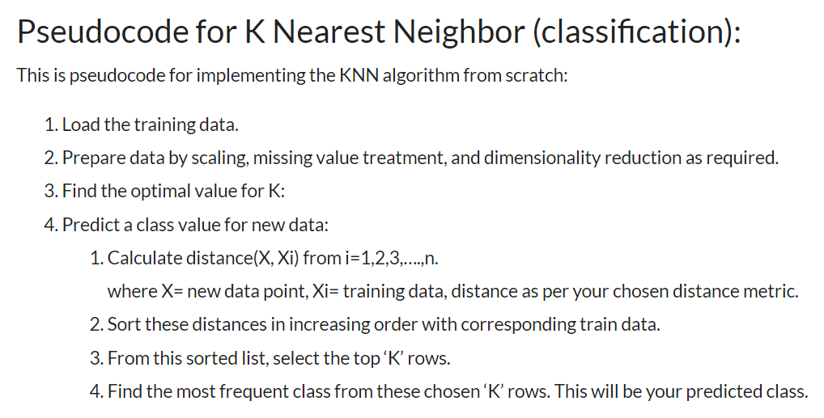
Algorithms
Algorithm K-Nearest-Neighbor (KNN) :
Input: 02152020-threats-02-15-2020.csv Dataset
Output: Success Accuracy of KNN trained Model on test Data

Slide 15
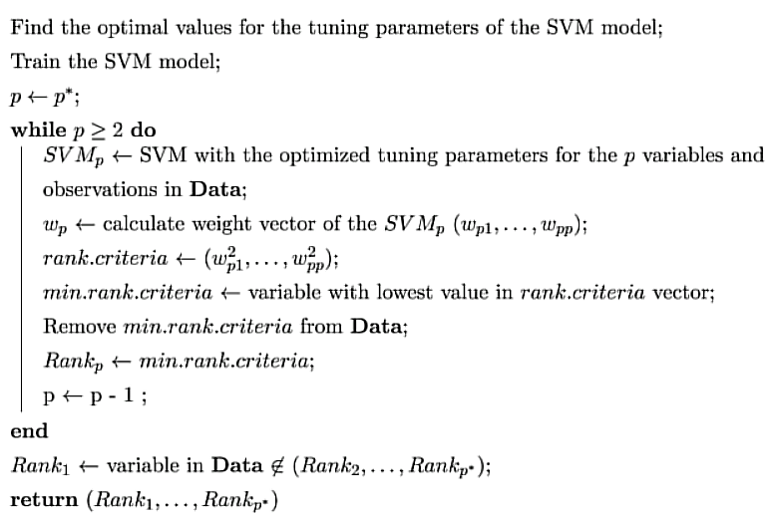
Algorithms
Algorithm Linear Support Vector Machine (SVM) :
Input: 02152020-threats-02-15-2020.csv Dataset
Output: Success Accuracy of SVM trained Model on test Data

Slide 16
Implementation Steps
Data Preprocessing
Label Encoding
Data Reshaping
Removal of Null values
Splitting of data for training and testing
Reshaping the data for SVM
Run the SVM model using a deep learning function
Visualization of Results
Build the Network and perform attack and generate the file
Use model to detect the attack and use SDN controllers to prevent the attack.

Slide 17
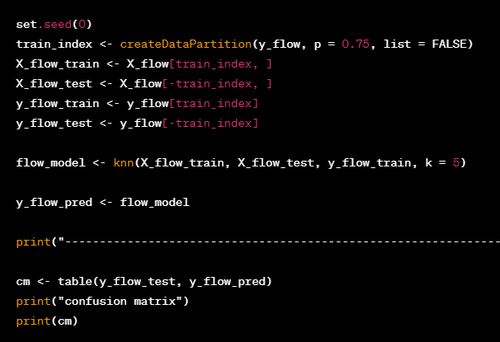
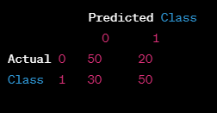
RESULTS
TRAINED KNN MODEL:

Slide 18
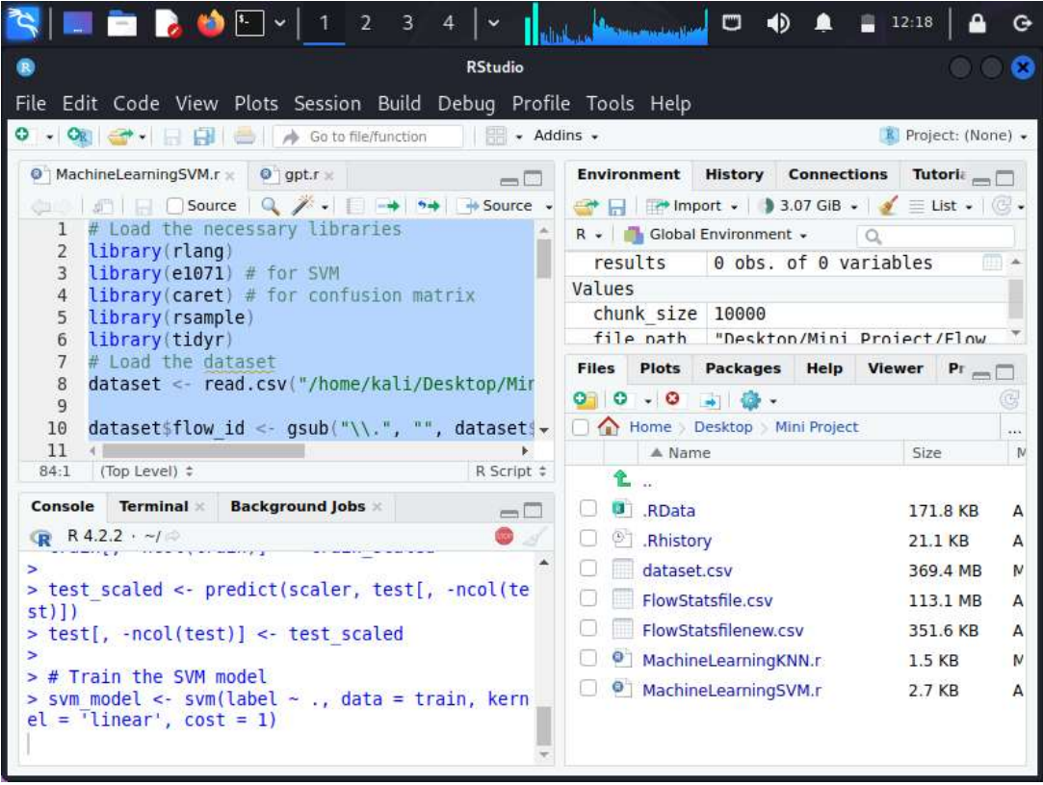
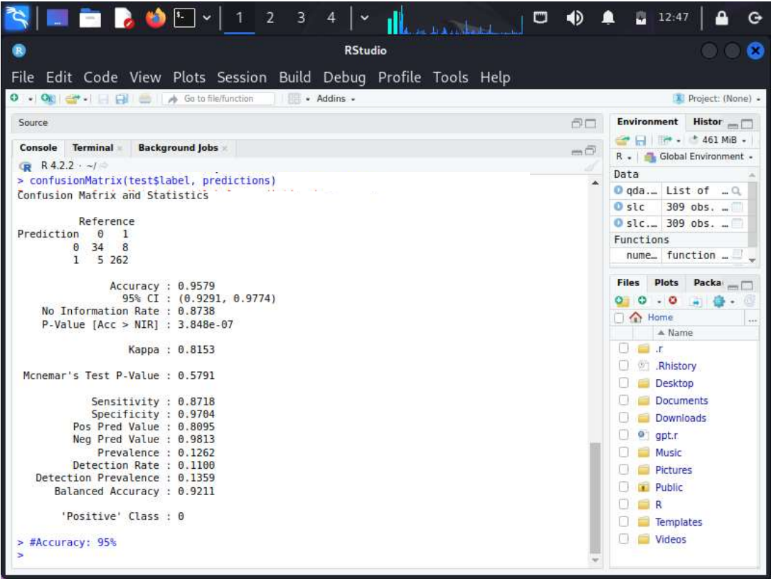
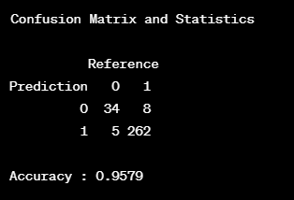
RESULTS
TRAINED SVM MODEL
Final Result:
The linear svm model is successfully evaluated with the validation dataset and got an accuracy of 95.79%

Slide 19
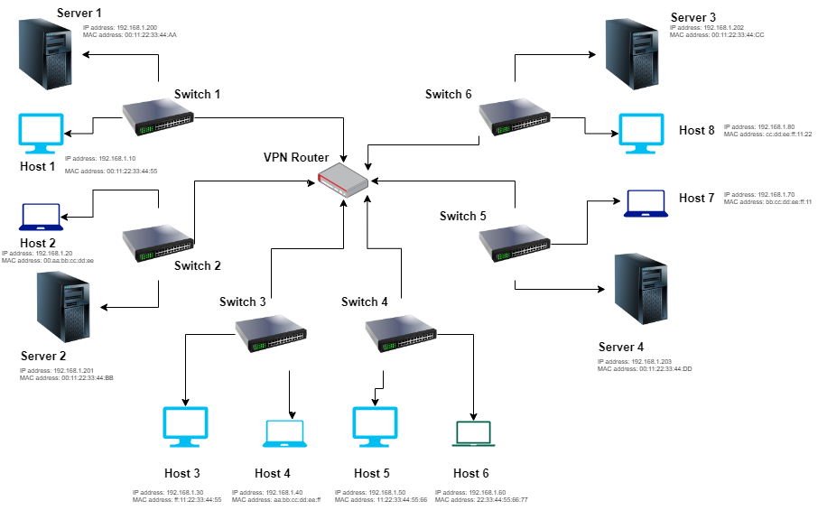
NETWORK TOPOLOGY
The above network is built using the Mininet to provide SDN environment

Slide 20
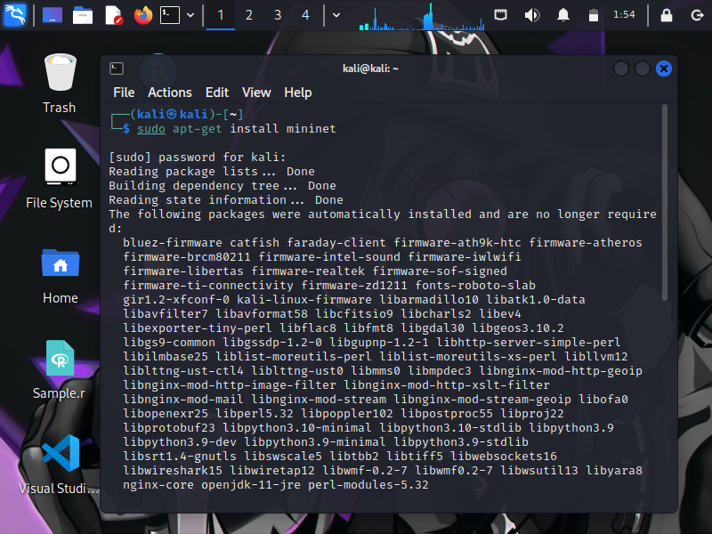
NETWORK USING MININET
from mininet.net import Mininet
from mininet.topo import Topo
from mininet.node import OVSSwitch, Controller
from mininet.cli import CLI
from mininet.link import TCLink
class MyTopology(Topo):
def __init__(self):
Topo.__init__(self)
# Add switches
switches = []
for i in range(6):
switch = self.addSwitch('s{}'.format(i+1), cls=OVSSwitch)
switches.append(switch)
# Add hosts
hosts = []
for i in range(8):
host = self.addHost('h{}'.format(i+1))
hosts.append(host)
# Add servers
servers = []
for i in range(4):
server = self.addHost('server{}'.format(i+1))
servers.append(server)
# Add links between switches and hosts
for i in range(len(hosts)):
switch = switches[i % len(switches)]
self.addLink(hosts[i], switch)
# Add links between switches and servers
for i in range(len(servers)):
switch = switches[i % len(switches)]
self.addLink(servers[i], switch)
# Add links between switches
for i in range(len(switches) - 1):
self.addLink(switches[i], switches[i+1])
topology = MyTopology()
# Create the Mininet network with the custom Ryu controller
net = Mininet(topo=topology, link=TCLink, controller=ryu_controller)
# Start the Mininet network
net.start()

Slide 21
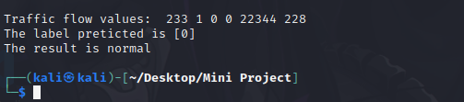
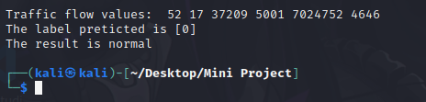
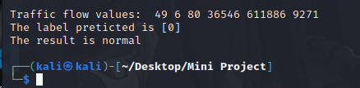
NORMAL TRAFFIC
RESULT OBTAINED WHEN ICMP TRAFFIC IS SENT
RESULT OBTAINED WHEN UDP TRAFFIC IS SENT
RESULT OBTAINED WHEN TCP TRAFFIC IS SENT
we specified the packet types as ICMP, UDP
and TCP

Slide 22
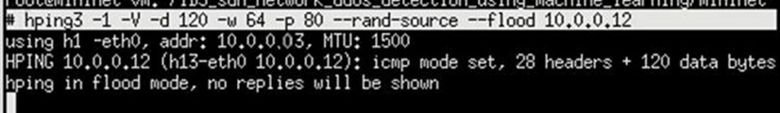
ATTACK TRAFFIC
PERFORMING ICMP FLOOD ATTACK USING HPING3
-1: Specifies the ICMP protocol for the flood ping attack.
-V: Enables verbose output, providing more detailed information during the attack.
-d 120: Sets the data size of the ICMP packet to 120 bytes.
-w 64: Sets the IP TTL (Time To Live) value to 64.
-p 80: Sets the destination port to 80.
--flood: Floods the target with ICMP packets at a high rate, generating a large volume of traffic.
Overall, this command launches a flood ping attack to the specified destination IP address, generating a high volume of ICMP traffic.

Slide 23
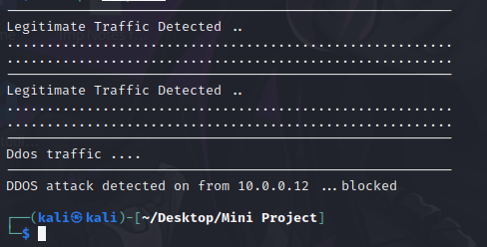
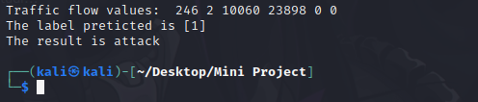
ATTACK IDENTIFIED AND BLOCKED
ICMP packets flood stopped by RYU Controller
# check IP Protocol and create a match for IP
if eth.ethertype == ether_types.ETH_TYPE_IP:
ip = pkt.get_protocol(ipv4.ipv4)
srcip = ip.src
dstip = ip.dst
protocol = ip.proto
# if ICMP Protocol
if protocol == in_proto.IPPROTO_ICMP:
t = pkt.get_protocol(icmp.icmp)
match = parser.OFPMatch(eth_type=ether_types.ETH_TYPE_IP,
ipv4_src=srcip, ipv4_dst=dstip,
ip_proto=protocol,icmpv4_code=t.code,
icmpv4_type=t.type)
RESULT OBTAINED WHEN ICMP FLOOD IS SENT
Here the attack is performed from host-4 with IP address : 10.0.0.12, so the attacker host is blocked from sending the further traffic.

Slide 24
CONCLUSION AND FUTURE STUDY
The proposed model has been developed successfully. Its performance is measured using the Accuracy metric and the result obtained is 95.79%. Also the model successfully detects the traffic and the attacker host is blocked based on the IP address.
Multiple attacks on the network will be performed and using more than one controller to prevent the attack. The model efficiency will also be increased by analysing more features in the future development.

Slide 25
REFERENCES
[1]. UllaZ and Q. H. Mahmoud, "Design and Development of a Deep Learning-Based Model for Anomaly Detection in IoT Networks," in IEEE Access, vol. 9, pp. 103906-103926, 2021, doi: 10.1109/ACCESS.2021.3094024
[2]. Z. Chkirbene, A. Erbad, R. Hamila, A. Mohamed, M. Guizani and M. Hamdi, "TIDCS: A Dynamic Intrusion Detection and Classification System Based Feature Selection," in IEEE Access, vol. 8, pp. 95864-95877, 2020, doi: 10.1109/ACCESS.2020.2994931.
[3]. Alqahtani H., Sarker I.H., Kalim A., Minhaz Hossain S.M., Ikhlaq S., Hossain S. (2020) Cyber Intrusion Detection Using Machine Learning Classification Techniques. In: Chaubey N., Parikh S., Amin K. (eds) Computing Science, Communication and Security. COMS2 2020. Communications in Computer and Information Science, vol 1235. Springer, Singapore. https://doi.org/10.1007/978-981- 15-6648
[4].F. Jiang et al., "Deep Learning Based Multi-Channel Intelligent Attack Detection for Data Security," in IEEE Transactions on Sustainable Computing, vol. 5, no. 2, pp. 204-212, 1 April-June 2020, doi: 10.1109/TSUSC.2018.2793284.-6_10

Slide 26


